Slide 1

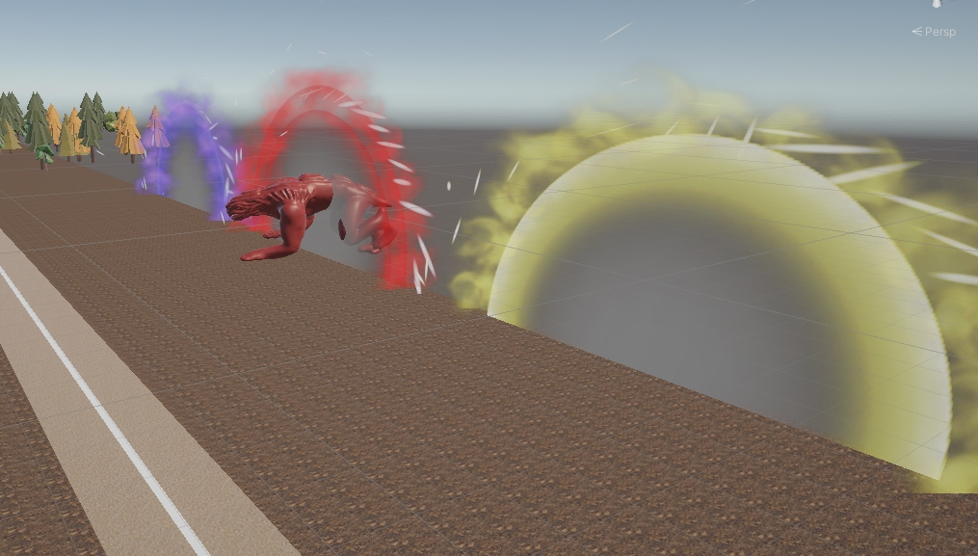
Alien invasion
Defend the town
Defend all alien waves
Save humanity
Use super powers
Save the city
Get the high score
Get a chance to save the humanity in this virtual reality alien invasion game, destroy them with super powers
Fight against alien AI and make sure to get rid of all of them !

